Slide 1
Remote Line Editor for Text Files
Client Server
By:
Daravath Dinesh Kumar
Nikita Mayee Sahoo
Suraj Bansal Guided by: -
Munesh Kushwah Sankar Banerjee
Ponnada Tejeswara Rao

Slide 2
CONTENTS COVERED
01
02
03
05
06
04
09
INTRODUCTION
Purpose
Data Flow Diagram
User Functions
Pseudocode
Test Cases
07
Server Functions
08
Client Functions
Non-Functional
Requirements
10
11
12
Application
Challenges Faced
Conclusion

Slide 3
Introduction :
Aim:-
The aim of this document is to gather, analyze and give an in-depth insight into the complete Remote Line Editor for Text Files application by defining the problem statement in detail.
The detailed requirements of the Remote Line Editor for Text Files application is provided in this document.
Intended Audience: -This application is intended to be use by, Client.
Intended Use:
Development Team
Maintenance Team
Clients

Slide 4
Purpose
Time-Saving
The best thing about this application is it help users to produce an error free result within a few seconds.
Easily Accessible
This application is compatible with almost every smart device having an internet connection.
No Installation required
This application don’t require any installation process and provides the best options for editing tasks

Slide 5
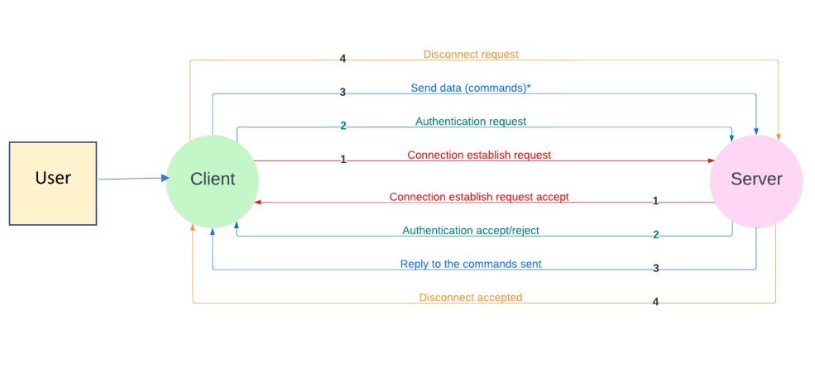
Data Flow Diagram
DFD Level 0

Slide 6
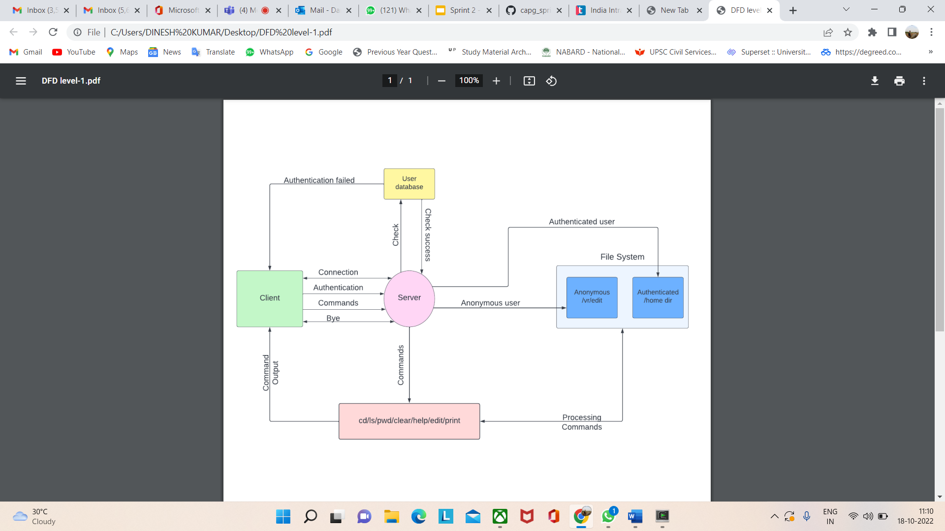
DFD Level 1

Slide 7
Pseudocode:- Click Here

Slide 8
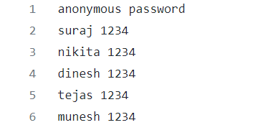
Test Cases

Slide 9
List of Functions (User)
void User(const char *name, const char *password,user *);
int ChangeUserDir(user *u,const char *new_dir);

Slide 10
Structure (User)
typedef struct User {
char name[100];
char password[100];
char dir[100];
} user;
We have a structure User and typedef it as user.
Inside structure we have name, password and directory of the user.

Slide 11
User
void User(const char *name, const char *password,user *);
This function is responsible to initialise the name , password and current directory of user inside the user structure.

Slide 12
Change User Directory
int ChangeUserDir(user *u,const char *new_dir);
This function is responsible to change the directory of user to the new directory.

Slide 13
List of Functions ( Server)
int createServer(ser *);
int LoadUsersData(ser *);
int AcceptConnections(ser *);
char *ReceiveDataFromClient(int clientfd, ser *);
int SendDataToClient(int clientfd, const char *data);
int AuthenticateUser(int clientfd, const user *user, ser *);
int ListDirContents(int clientfd, const char *dir);
int ChangeDir(const char *new_directory, user *current_user, int client_socketfd, ser *);
int EditLine(int clientfd, const char *file, int linenum, ser *);
int ViewFile(int clientfd, const char *file, int start, int end, ser *);
int SelectFile(char *filename, const char *dir, int clientfd);

Slide 14
Structure ( Server)
typedef struct Server {
int socketfd;
struct sockaddr_in server_addr, client_addr;
socklen_t client_addr_size;
user users[100];
int n;
int s;
char buffer[MAX_SIZE];
} ser;
We have structure Server and typedef it as ser
Inside the structure we have socketfd, Server address , client address , its size , a user array . a variable named n which acts as a index of array, variable s for client id and a char array named buffer.

Slide 15
Create Server
int createServer(ser *);
Under create server
we create a socket using socket system call
then we initialize server address
then we bind the socket to server address
at last we listen for connections

Slide 16
Load User Data
int LoadUsersData(ser *);
This function is responsible to read data from the user.txt file.
User.txt file is present inside data directory.
After reading from the txt file we need to store it in the user array .
The username should be stored corresponding to username char array in user structure likewise password should also be stored.

Slide 17
Accept Connections
int AcceptConnections(ser *);
This function is responsible for accepting connection from client.
Accept system call is used to perform this action.

Slide 18
Receive Data From client
char *ReceiveDataFromClient(int clientfd, ser *);
This function is responsible to accept data from client.
Using memset system call we initialize the buffer to 0.
Then using recv system call we receive data and store it inside buffer.

Slide 19
Send Data to client
int SendDataToClient(int clientfd, const char *data);
This function is responsible to send data to client using send system call.

Slide 20
Authenticate User
int AuthenticateUser(int clientfd, const user *user, ser *);
This Function is responsible to authenticate the user based on the username and password received.
If the credentials are correct then it is a authenticated user.
If credentials are incorrect then it returns back to client stating authentication failed.
If credentials are empty then it is a anonymous user.
In this function firstly we have to check whether any user are present inside the user array or not.
We can do so by using checking the ser->n.
Then we compare the username and password and based on the comparison we send authenticated or not authenticated message.

Slide 21
List Directory Contents
int ListDirContents(int clientfd, const char *dir);
This function is responsible to list down all the contents inside directory.
In this function we have used DIR structure and opened and read the directory.
After that by comparing the d_type value we have classified contents into further directory or files.
Then we have stored the contents inside buffer.
If the buffer is empty then we will print empty directory.
If not empty then we send the data to client.

Slide 22
Select File
int SelectFile(char *filename, const char *dir, int clientfd);
This function is used to select a filename.
We are using a pointer of DIR structure to open a directory and read it.
In the filename we are storing the complete address of file to be selected.
After that we are sending the message FILE SELECTED message.

Slide 23
Change Directory
int ChangeDir(const char *new_directory, user *current_user, int client_socketfd, ser *);
This function is responsible to change the directory.
We are using a pointer of DIR structure to open a directory and read it.
Then we are calling the the ChangeUserDir function to change the user.
We are using a temp variable to store the new directory.
After successfully changing the directory we are sending the message DIRECTORY CHANGED.
Also if we try to access to ./data/home directory it will be restricted.

Slide 24
Edit Line
int EditLine(int clientfd, const char *file, int linenum, ser *);
This function is responsible to change the edit the content in the specified line number in the file.
We are opening the file in read mode.
Then we have temp 2D char array name lines and we are storing the contents of file.
Then we are calculating the number of lines inside the file and comparing it with the value received from command.

Slide 25
View File
int ViewFile(int clientfd, const char *file, int start, int end, ser *);
This function is responsible to print the file contents from start and end line.
In the beginning we calculate the line numbers and then we compare the value with start line and end line.
After that using for loop we send the data to client from start line to end line.

Slide 26
List of Functions ( Client)
int CreateSocket(c *);
int ConnectToServer(c *);
int AuthenticateUser(char *username, char *password,c *c);
int SendDataToServer(char *data,c *c);
char* ReceiveDataFromServer(c *c);
int DisconnectClient(c *c);
int EditLine(c *c);
int ReceiveFile(c *c);

Slide 27
Structure ( Client)
typedef struct Client {
int socketfd;
struct sockaddr_in server_addr;
int isConnected;
char buffer[MAX_SIZE];
}c;
We have structure Client and typedef it as c
Inside the structure we have socketfd, Server address , a variable isConnected to check whether client is connected to server or not and a char array named buffer.

Slide 28
Create Socket
int CreateSocket(c *);
Under create server
we create a socket using socket system call,
then we initialize server address

Slide 29
Connect to Server
int ConnectToServer(c *);
This function is responsible to connect client to server using connect system call.
After connection we are changing the value of isConnected to 1.

Slide 30
Send Data to Server
int SendDataToServer(char *data,c *c);
This function is responsible to send data to server.

Slide 31
Authenticate User
int AuthenticateUser(char *username, char *password,c *c);
This function is responsible to authenticate user.
Inside this function we are using a data variable and storing AUTHENTICATE and then username and password.
After that we are sending this data to server to process authentication at server end.
If server sends message as AUTHENTICATED in buffer then the credentials matched.
If NOT AUTHENTICTATED is received then credentials did not matched.

Slide 32
Receive Data from Server
char* ReceiveDataFromServer(c *c);
This function is responsible to receive data from server via the buffer char array.

Slide 33
Receive File
int ReceiveFile(c *c);
This function is responsible to check whether file is selected or not.
We receive the information in buffer.
If the buffer value of c is 0 then that means FILE is not selected
Otherwise File is selected.

Slide 34
Edit Line
int EditLine(c *c);
In this function we first compare the value of buffer of client
If the value is 0 then file is not selected
If the value is Invalid line number then same message is shown.
After that we ask the user to enter the changes in file .
After we have received the input Send the Data to Server.

Slide 35
Disconnect Client
int DisconnectClient(c *c);
This function is used to close the socket via close system call.

Slide 36
Non-Functional Requirements
Makefile Link:- Click Here
Valgrind Report:- Click Here
Tools to be used
Makefile:- It is a way of automating software building procedure and other complex tasks with dependencies.
It is a set of commands with variable names and targets to create object file and to remove them.
Valgrind:- To detect memory leaks.

Slide 37
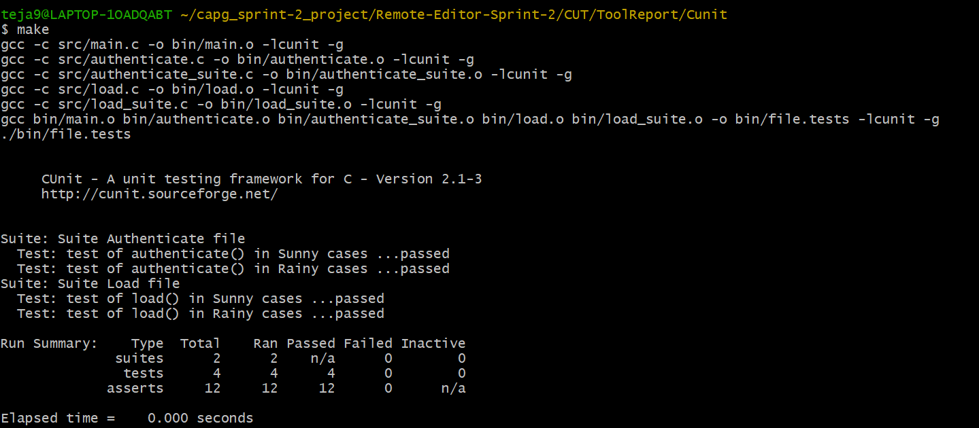
C Unit:-

Slide 38
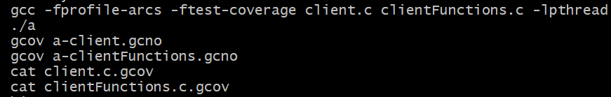
Gcov-Tool
It is offline gcda profile processing tool.

Slide 39
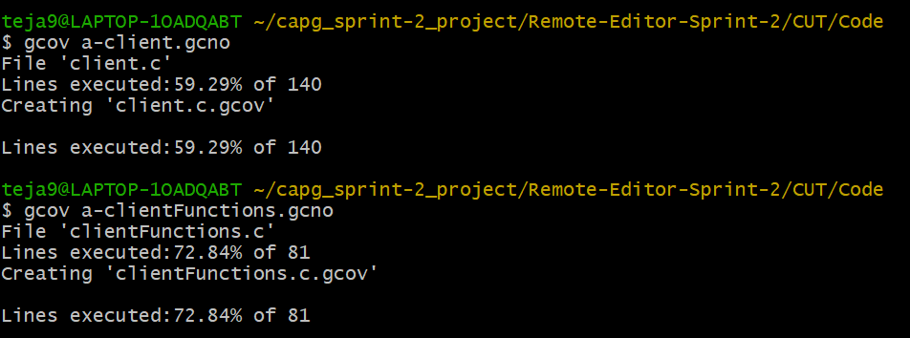
Gcov-Tool

Slide 40
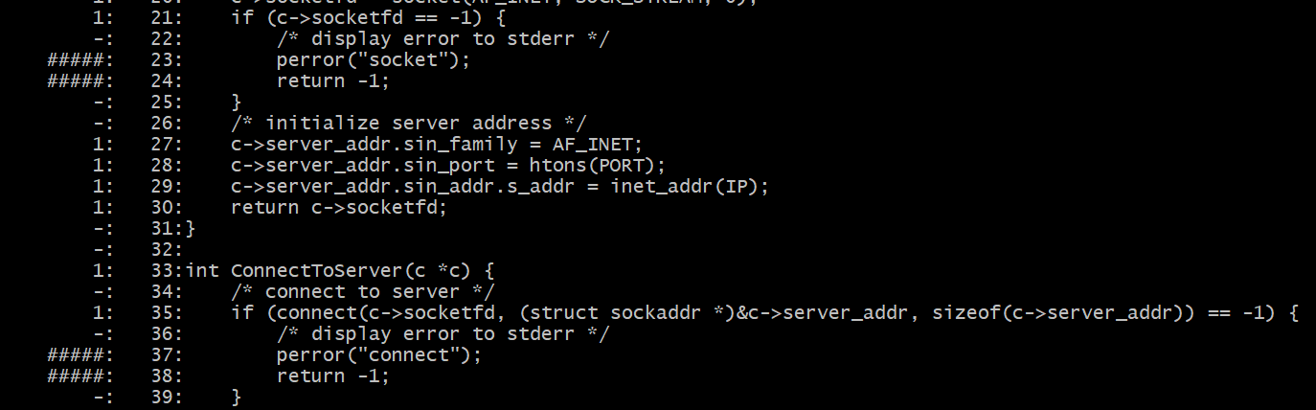
Gcov-Tool

Slide 41
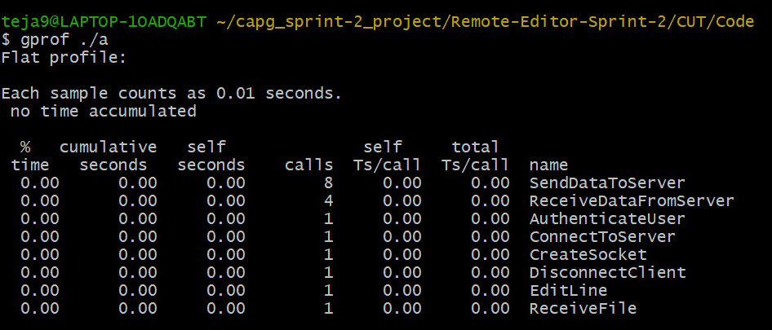
Gprof-Tool

Slide 42
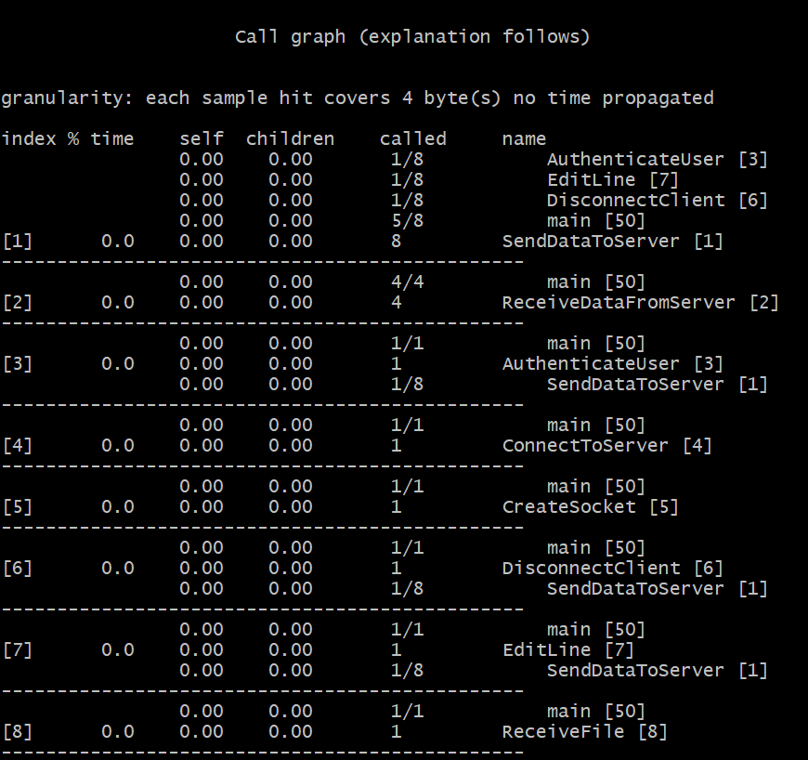
Gprof-Tool

Slide 43
Application
This application can be useful for users to edit there text files easily from any device having internet connection.
They easily assess this application by just there User Id and Password from any device.
This application don’t require any installation process and provides the best options for editing tasks and it is compatible with almost every smart device.

Slide 44
Challenges Faced
Choosing appropriate structures
Satisfying all the requirements
Deciding on functions to be used
Constantly improvising the code
Handling errors

Slide 45
Conclusion
`
The purpose of this application was to identify effective strategy of editing text files by multiple users in less time from any device having internet connection without any installation.

Slide 46
Github Link:- Click Here

Slide 47
THANK YOU

